Slide 1
Transient Heat Conduction in Nuclear Fuel Pin
Presentation By
(2022UCS0106) Rishabh Raj
(2022UCS0092) Hitesh Choudhary

Slide 2
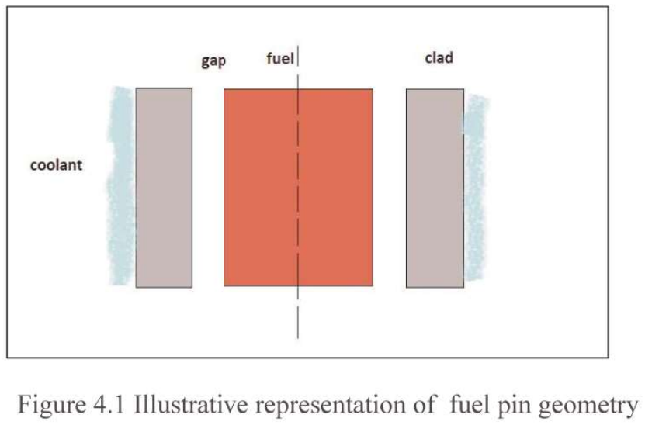
Radial Heat conduction in nuclear fuel elements
Reactor fuel pin is a cylindrical fuel element that contain fuel pellet, gap and cladding as shown in Figure 4.1. Coolant can be in single phase or two phase. Fuel and clad properties are available as a function of temperature. The state of the coolant is obtained from convection equations. Thus, the information is provided by these to transient conduction solver. As the equation is non-linear due to complex property and boundary conditions, numerical solutions are called for

Slide 3
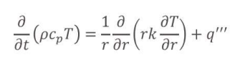
Basic governing equation (after Over assumption of azimuthal symmetry and neglecting axial conduction affects )

Slide 4
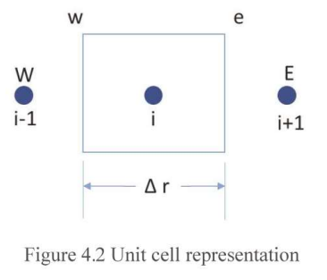
Discretized equations for fuel pin geometry (using finite volume approach)
In this section, the governing equation (shown in the previous slide) is integrated over volume and time at node_{i} to obtain the discretized equations.

Slide 5
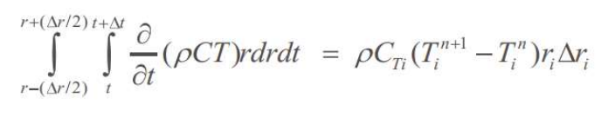
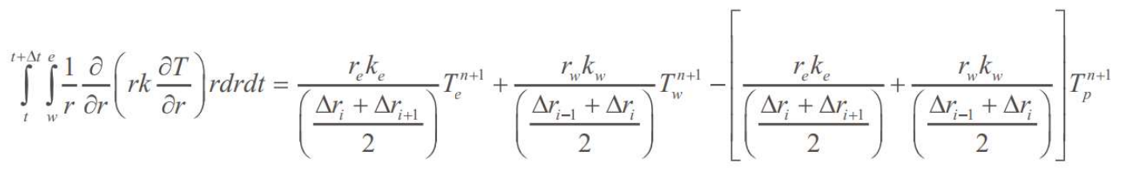
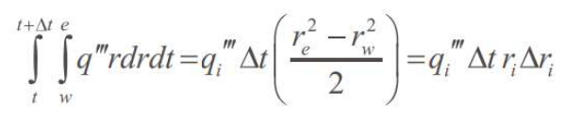
I. Transient term II. Conduction term III. Heat generation term
T_{i}^{n+1} T_{i+1}^{n} represents average values in the control volume at n+1th and n^{th} timesteps at i^{th} node location.

Slide 6
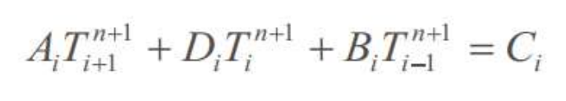
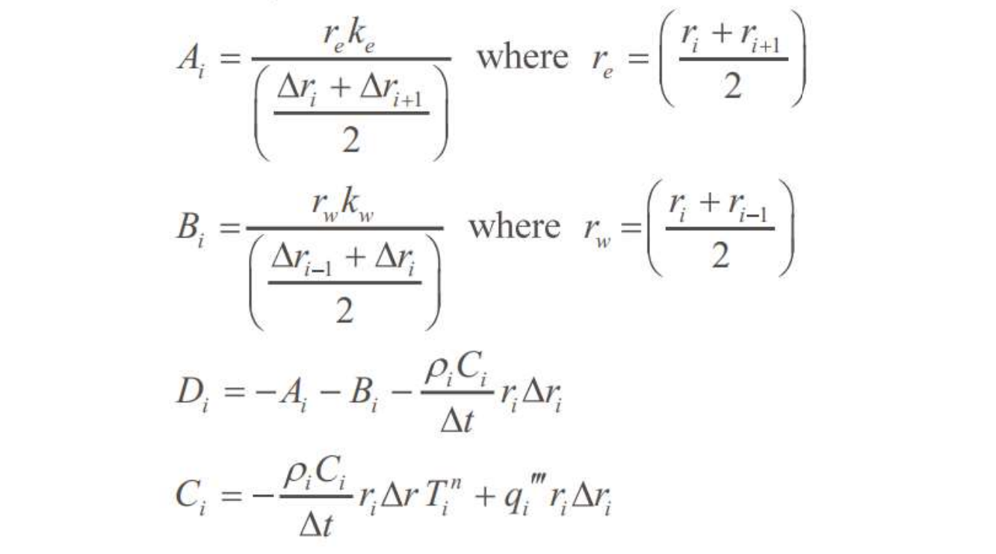
On substituting the equations in the previous slide in the Governing Equation, we get:

Slide 7
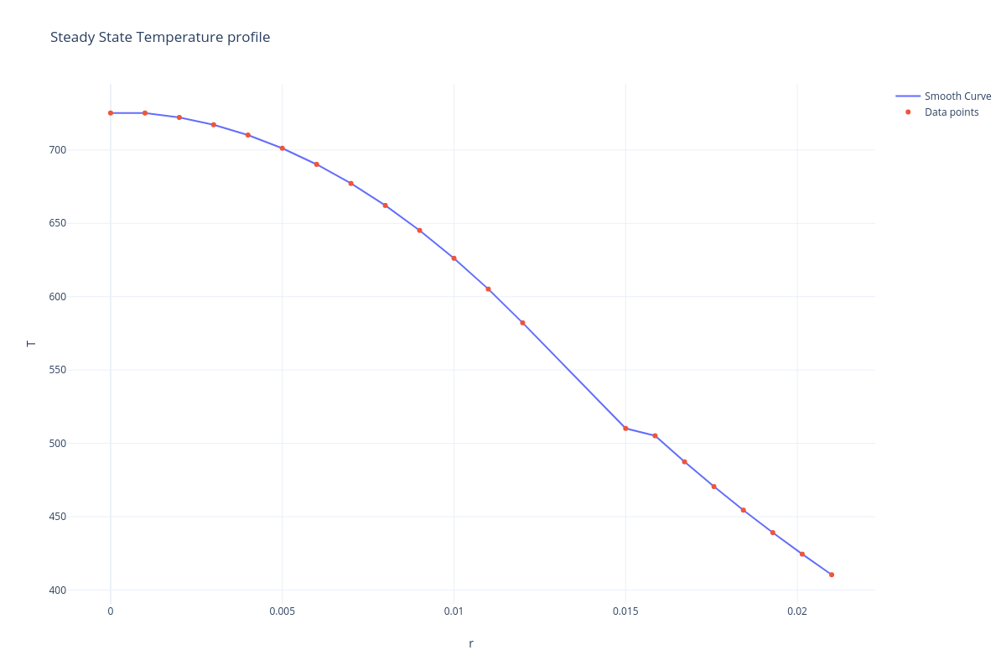
Steady State Temperature Profile

Slide 8
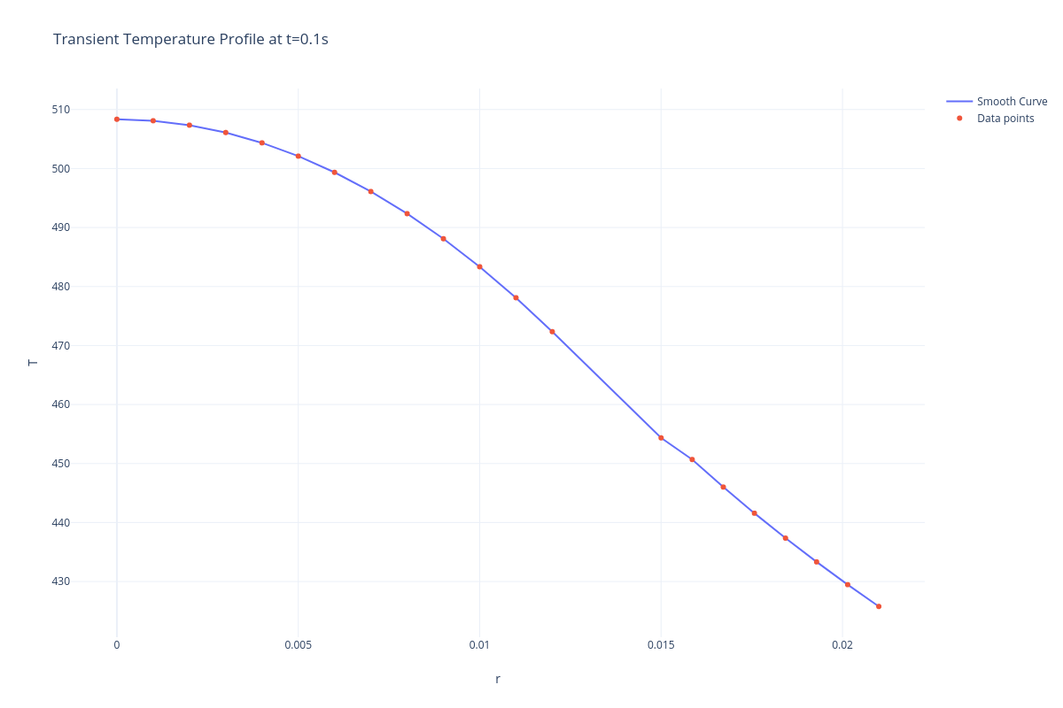
Transient Profile at t=0.1s

Slide 9

Transient Profile at t=0.3s

Slide 10

Transient Profile at t=0.5s

